Slide 1








Accelerating Your
CAREER GROWTH
By Wanjiru Kihusa

Slide 2

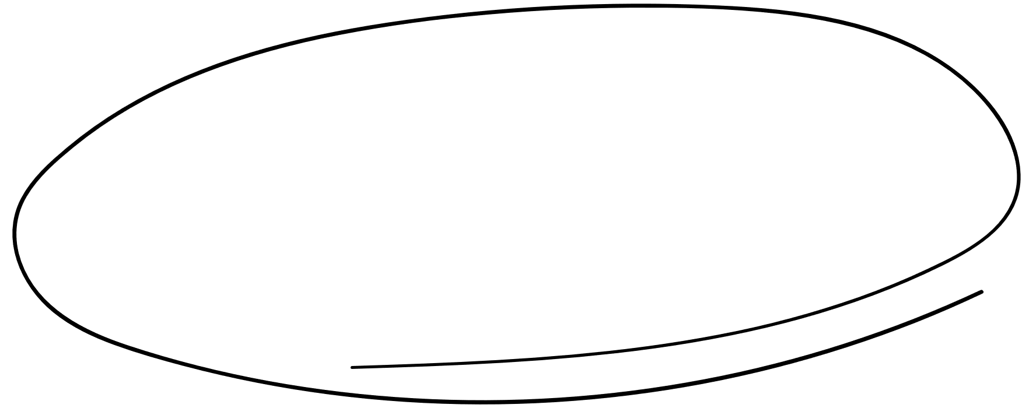

Content
1
4
INTRODUCTION
GRATITUDE + AMBITION
2
5
PERSONAL BRAND
CONCLUSION
3
6
WORK ETHIC + VISIBILITY
Q & A

Slide 3

Introduction
Whether you're just starting out or looking to take your career to the next level, this presentation is designed to provide you with the tools, strategies, and insights you need to fast-track your professional journey.
In today's fast-paced and ever-evolving job market, it's crucial to stay ahead of the curve.

Slide 4



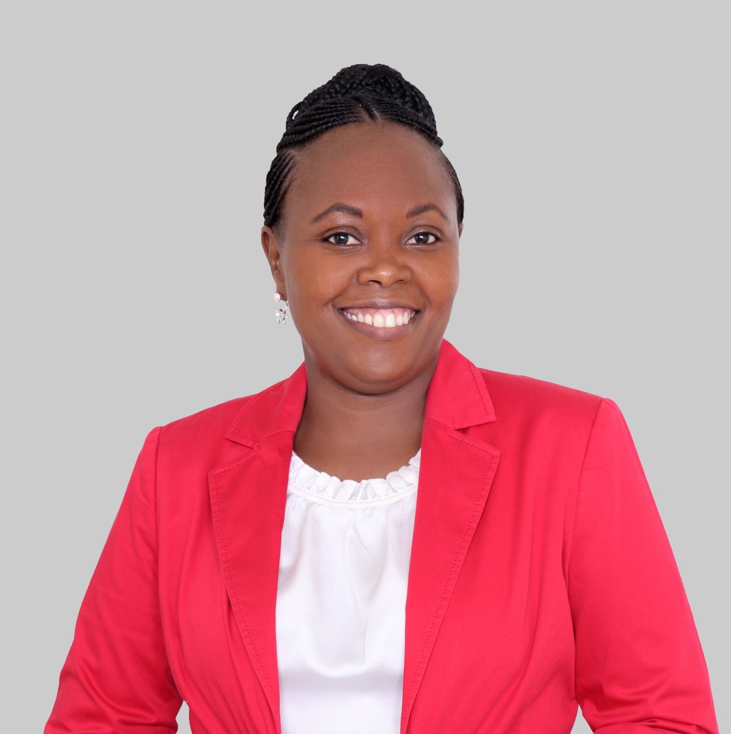

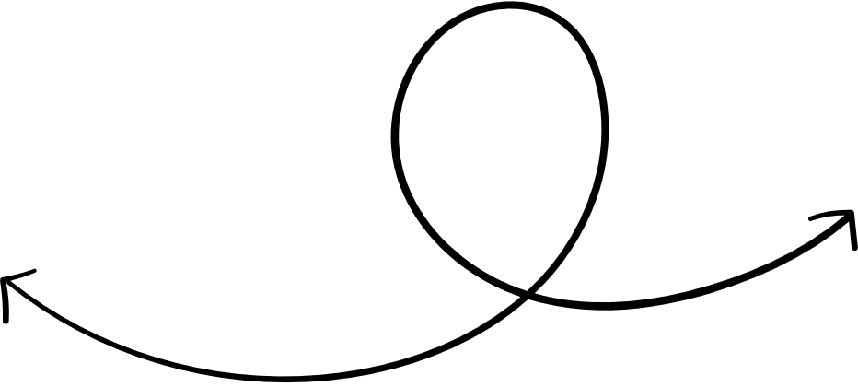

About me
Hi, I'm Wanjiru , the Global Humanitarian Relief Director at UPS. I lead high-impact humanitarian projects across EMEAI, APAC, and LATAM, managing strategic philanthropy and community partnerships. With over a decade in social impact, I drive initiatives that align with UPS's values, focusing on equitable health disaster & humanitarian response
Wanjiru Kihusa

Slide 5


Building a personal brand
Do you stand out?
* What people say about you when you're not in the room.
* Differentiates you, builds trust, and creates opportunities.
* Authenticity: It's genuinely you. Not a fabricated persona.
* Consistency: Delivering on your promise across all platforms.
* Clarity: What do you stand for? What problems do you solve?
* Value: How do you add value to others?
* Visibility: Being seen by the right people.

Slide 6
Building a personal brand
Your Unique Value Proposition
* What are your core values?
* What are your strengths and unique skills? (Think beyond your job description)
* What are you passionate about?
* What kind of problems do you love to solve?
* What do you want to be known for?
* Who is your ideal audience/who do you want to influence?

Slide 7
Building a personal brand
Build Your Online Presence (Digital Shopfront)
* LinkedIn (Non-Negotiable):
* Professional photo & compelling headline.
* Detailed experience, skills, and endorsements.
* Actively engage: share content, comment thoughtfully.
* Publish articles/posts related to your expertise.
* Other Social Media (Strategically): Consistency across platforms.

Slide 8
Building a personal brand
Maintain & Evolve Your Brand (Ongoing)
* Regular Review: Is your brand still aligned with your values & goals?
* Feedback: Ask for constructive criticism (from trusted colleagues, mentors).
* Adapt & Grow: Your brand should evolve as you do.
* Professional Development: Continuously learn new skills, gain certifications.
* Manage Your Reputation: Address negative feedback professionally.

Slide 9

Working Hard AND Smart for Visibility
Strategies for Efficient Effort & Recognition
* Prioritize High-Impact Tasks: Focus on projects that align with your goals and company objectives.
* Document Your Accomplishments: Keep a record of your successes with quantifiable results.
* Seek Feedback Regularly: Proactively ask for input on your performance and areas for improvement.
* Volunteer for Stretch Assignments: Take on challenging projects that allow you to showcase your skills.
* Communicate Effectively: Clearly articulate your contributions and their impact.
* Build Relationships with Key Stakeholders: Network internally with managers, leaders, and colleagues.
* Find a Mentor/Sponsor: Seek guidance from someone who can advocate for you.

Slide 10

Balancing Gratitude and Ambition
Embracing Grateful Ambition
* Acknowledge Your "Why": Regularly reflect on what you appreciate about your current role, team, and company.
* Define "More" with Intention: Instead of just wanting "more," get specific. Do you want to learn a new skill, take on a leadership role, contribute to a different type of project, or mentor others?
* See Growth as an Extension, Not a Rejection: View your ambition as a natural progression from your current positive state, rather than a sign of dissatisfaction.

Slide 11
Balancing Gratitude and Ambition
Practical Strategies for Grateful Growth
* Set Micro-Goals: Break down larger ambitions into smaller, manageable steps.
* Leverage Your Current Role: Look for opportunities to apply and develop new skills within your existing position.
* Communicate Thoughtfully: If you're discussing your ambitions with your manager, frame them in terms of how your growth can benefit the team or company. Express your enthusiasm for your current role while outlining your desire to expand your contributions. This demonstrates loyalty and a proactive approach.
* Practice Active Gratitude: Take time each day or week to list specific things you're grateful for about your job.

Slide 12



Conclusion
Be deliberate with your career journey

Slide 13


Thanks!

